Slide 1

BHAKOO TRAINING INSTITUTE
Director
Group Captain Ashwani Bhakoo VSM
MSc (Strategy & Defence) , MS, (Psychotherapy and Counseling), PGDPC (Psychotherapy and Counseling), MMS (Strategic Management and HR) , Diploma in Advanced Management, Qualified Flying Instructor, Pilot Attack Instructor

Slide 2
Programs Undertaken
Leadership Programs - Communication Skills – Motivation Skills
Innovative Thinking – Out of the Box Thinking
Negotiation Analysis
Effective Sales Techniques – Attitude Building
Presentation Skills – Body language – Interview Skills
Team Building - Time Management – Goal Setting
Stress Management - Emotional Intelligence
Certificate Course in Aviation Management
Training for Commercial Pilot License – All subjects, Flying training.

Slide 3
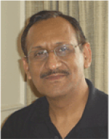
The Trainer: Group Captain(Retd) Ashwani Bhakoo VSM
MSc (Strategy & Defence) , MS, (Psychotherapy and Counseling), PGDPC (Psychotherapy and Counseling), MMS (Strategic Management and HR) , Diploma in Advanced Management, Qualified Flying Instructor, Pilot Attack Instructor
CEO, Bhakoo Training Institute ™
Life Skills Trainer, Psychotherapist and Counselor
Trustee: Connecting NGO and CYDA (Centre for Youth Development Activities)
Member NHRD and USI (United Services Institute for Strategic Thinking)
Pilot with 6000h flying, 2000 plus Instructional, vast International Exposure in Europe, US, China, SE & SW Asia.
25 years of experience in People Management & Human Resource Development
Founder and Instructor at ‘Centre for Leadership and Behavioral Sciences’; Conducted training for 1000+ Indian Air Force Officers and families across the country.
Commanding Officer of frontline fighter unit during Kargil Operations (1999): Unit Awarded 7 Gallantry Awards
Awarded Vishisht Seva Medal by the President of India for excellence in service and innovative thinking.
Alumni of National Defence Academy, Osmania University, Chennai University, Royal Air Force College, UK

Slide 4














Clients

Slide 5

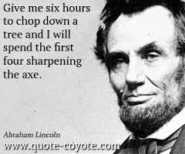
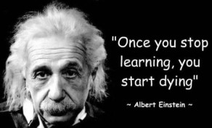
Purpose of the Training
The axe represents your tools, skills, mindsets, knowledge, talents and gifts. The sharpening process is how you prepare for and improve your craft and indeed, your life.

Slide 6
Sample Training Plan
This plan is based on the following:
  Company Brief on Training Requirement / Focus Areas
  Time Availability
  Location – Indoor or Outdoor

Slide 7
Training Requirements as per Brief
Venue : Indoor Training (Company / Hotel)
Participants:
Duration: 2 Day Training – 17th and 18th Nov 2014
Profitability Growth through Enhancing -
25-30 participants
Age Group: 30years+
Sales Managers , BE, BE+MBA
Leadership Skills
Presentation and Communication Skills
Out of the Box / Innovative Thinking

Slide 8

Purpose of the Training

Slide 9
Training Schedule (Activity Based)
Leadership Skills
Psychometric tests for understanding Leadership styles and Motivation Levels
Communication and Presentation Skills
Presentation Activities
Out of the Box Innovative Thinking
Discussion on Human Behavior, Perceptions, Self Concept, Emotional Intelligence, Motivational Techniques.
Solving Real-World Problems– individual and team
Effective Communication
Detailed Debriefs
Group Learning and Feedback Session
Self Concept Training
Behavior Activity Profiling
Strategy Games
Improving Interpersonal relations using Johari Window
Delegation

Slide 10

Psychometric Tests
Psychometric Tests are tools to understand the present status of participants
These are followed by suggestions to bridge the gap and improve productivity
Each Participant gets individual inputs on how they can improve and grow to become a better leader
Where you want to be
Self Awareness
From where you are

Slide 11
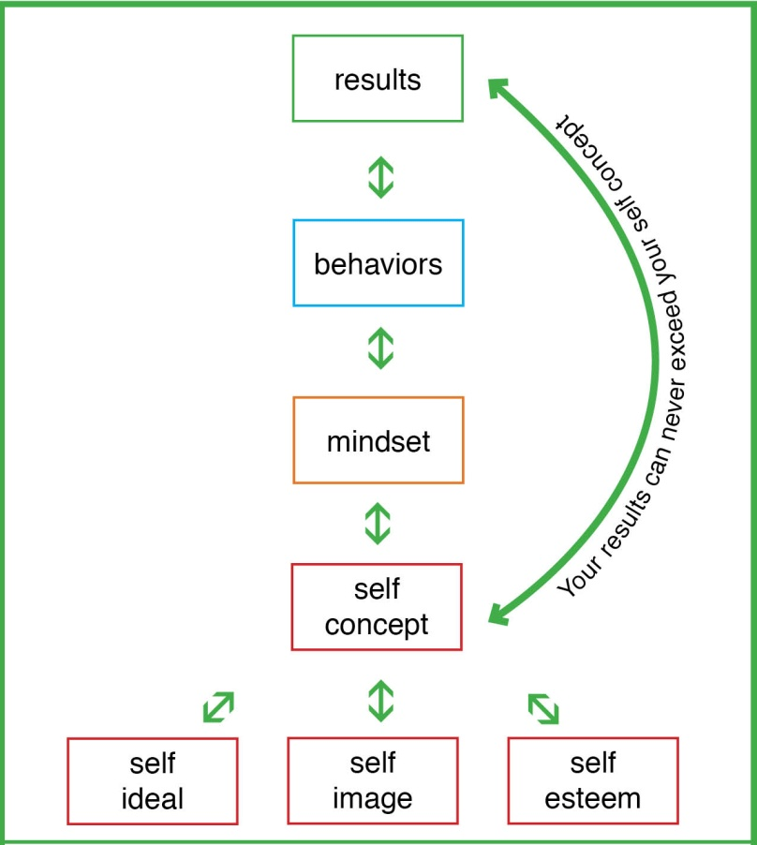
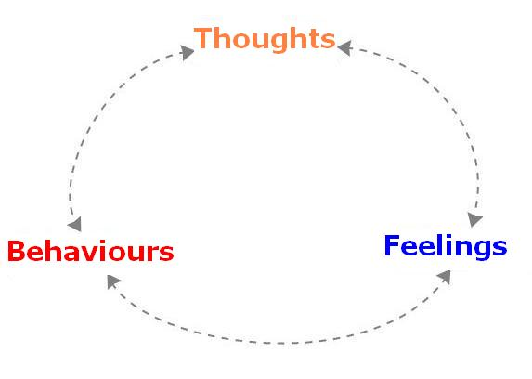
Self Concept Training
Self Concept Training includes understanding the difference who we think we are, who others think we are and who we really are.
Help Recognize and Realize the impact of Self Concept on Results
Modification of Thoughts to Enhance Productivity

Slide 12


Communication & Presentation Training
Mindful Listening Skills
Understanding Client Needs
Creating Effective Presentations
Use of Correct Verbiage
Handling Communication Barriers
Improving Interpersonal relations using Johari Window

Slide 13
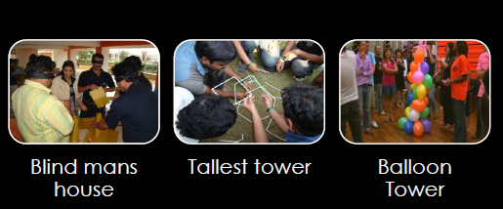
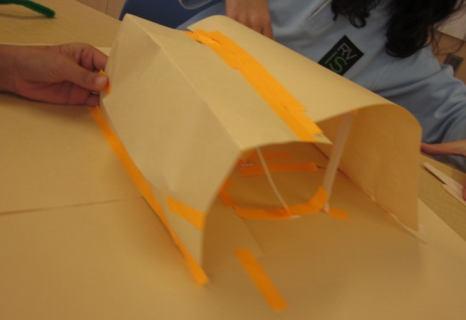
Some Leadership and Strategy Games
Blind House
Concepts Experienced:
Trust Building
Team work
Resource Management
Effective Communication
Tallest Tower
Concepts Experienced:
Collaborative work
Strategic Allocation of Inputs
Out of the Box Thinking
Balloon Tower
Concepts Experienced:
Problem Solving
Coordination Among Diverse Teams
Time Management
Innovative Solutions
Bridge Building
Concepts Experienced:
Innovative Thinking
Strategic Approach
Implementation of Ideas and Strategies

Slide 14
Commercials
Trainer fee
Space arranged by Company for conduct of session inclusive of Video projector and sound system. (This can be arranged by us)
Travelling as per actual to be arranged/borne by company.
Assistance from company for Xeroxing and supplying Training notes etc to participants. (this can be arranged by us)

Slide 15
Contact Us
Ashwani Bhakoo
Mobile: 9922940308 bhakoo@hotmail.com www.ashwanibhakoo.com

